Slide 1
Architecture Operating Model
- Seeking Endorsement from CIO Council

Slide 2

Architecture Operating Model drives consistency across the organisation
The Architecture Operating Model (AOM) is to address the “How” to make ARCHITECTURE MANAGEMENT STANDARD - F20220701 aligned and delivered.
Architecture Management Standards
Standard Index | Control Standard Statement
TSI.AM.EOA.CR01 | Global Head of Architecture must develop and maintain Architecture Operating Model to: assign roles and responsibilities in Architecture Management determine architecture governance bodies to be created determine type of common practices to be defined and enforced determine choice of tooling and level of centralization of architecture repositories
TSI.AM.EOA.CR02 | Global Head of Architecture must ensure Architecture Operating Model is reviewed annually and endorsed by Group Chief Information Officer (GCIO).
Business / Technology Strategies alignment
Investment to Strategies alignment
Drive standardization, simplification and cost optimization
Consistent architecture operating model across the bank
Centralized repos and tools for execution efficiency and monitoring
Cross business Regulatory requirements
Why Architecture Management Standards

Slide 3
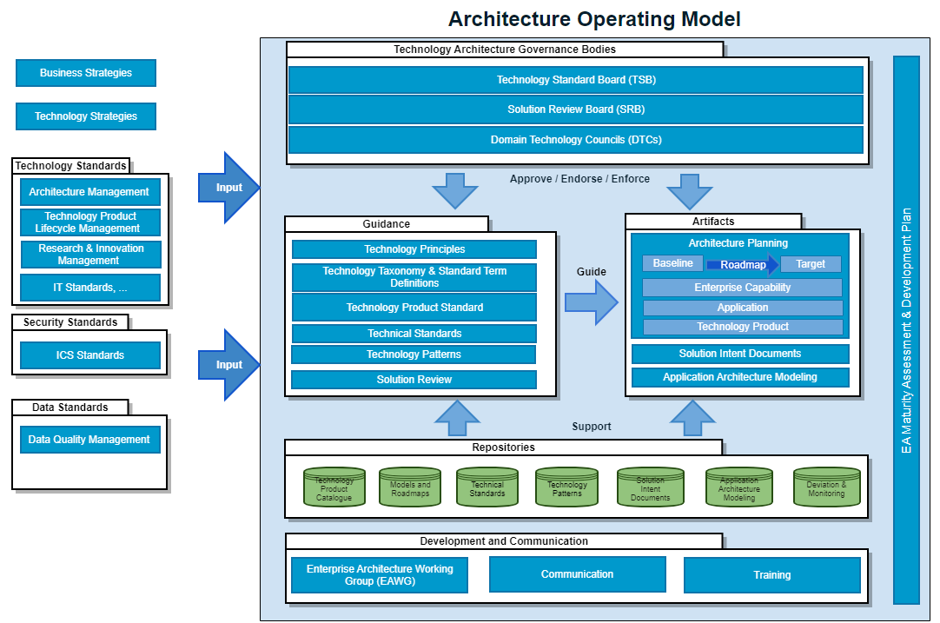
Architecture Operating Model on a page

Slide 4
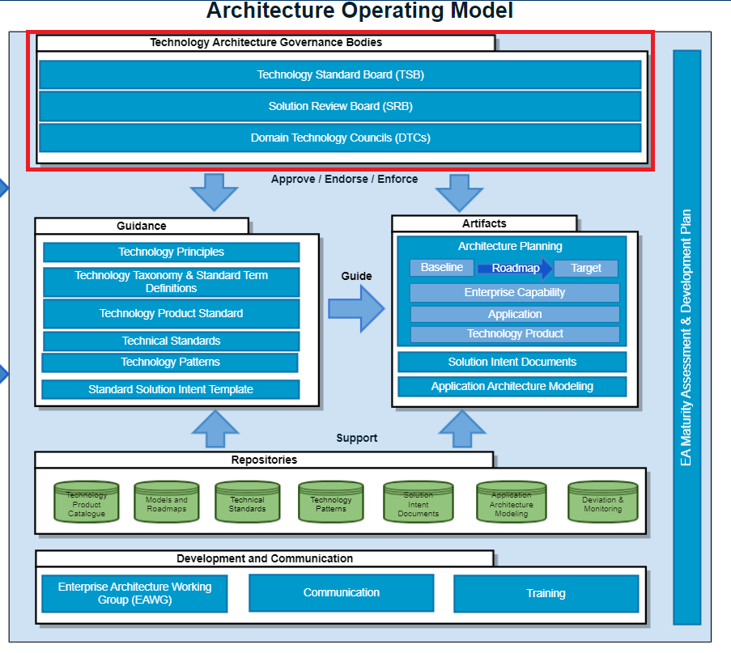
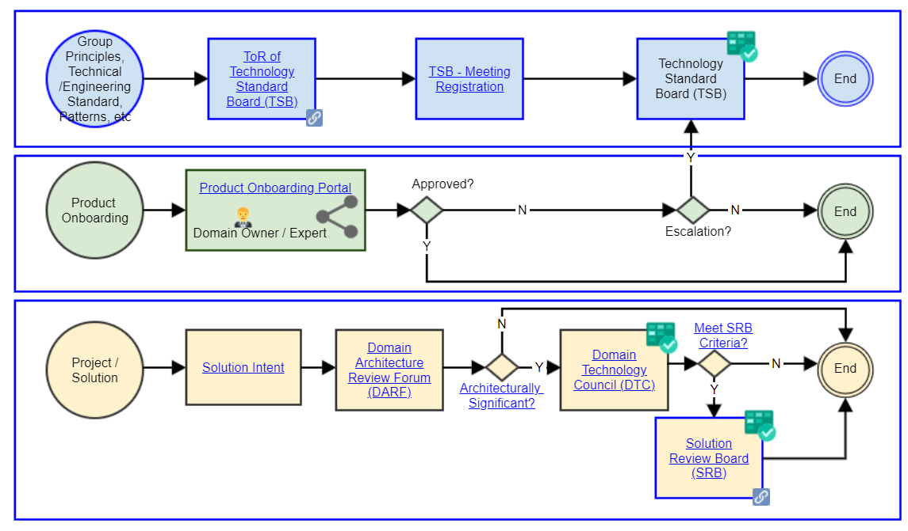
Group wide Governance Bodies established and driving simplification
TSB:
Define technology standards & direction
Provide guidance to technology design, delivery and operations
Support Technology Governance and Risk Management
Be the technology escalation center to support frictionless operations
Product related
DARF & DTC:
Domain specific detail technology review and governance
SRB Criteria:
Large Investment ($10 M over 3 years)
Group Strategic Programs
Cross domain impact with escalations
MCAP – PRA related assurance
Recommended by Domain Chief Architect

Slide 5
Guidance and Artifacts ensure consistent decision making and deliverables

Slide 6
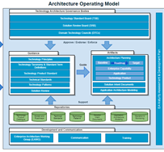

Guidance allows Architects to make well informed decisions
Guidance
In Place
Architecture Governance Body
Setup & Operationalization of TSB, SRB and DTCs
Technology Principles
A principle for decision making guidance in technology solution
In Place
Taxonomies and Term Definition
Standardized technology-related taxonomies and technology-related term definitions
WIP (50%)
Technology Product (Target) Standards
Annual review on technology product (target) standards
Guide for group adoptions on standardized products
In Place
Technical Standards
Guide technology implementation (i.e API Technical Standards)
Procedure, template and repo
In Place
Technology Patterns
Guide on reusable design pattern, development and deployment patters (i.e. scarf, Cloud deployment pattern, integration patterns)
Procedure, template and repo
In Place
Solution Review
Procedure, Solution Intent document template, guidance
In Place

Slide 7

The Banks architecture principles…
Set us on the path towards a refreshed target state and enablement of simplification and resilience
Be Compliant
Loose Coupling
Stateless
Portability
Design for Automation
Build for Open Standards
Observability
Mitigate Data Loss
Externalise Configuration
Design with API’s
Smaller Footprints
Data Recoverability
Use the Platform
Adapt to Change
14
PRINCIPLES
PRINCIPLES
Link: Technology Principles

Slide 8
Artifacts enable consistent outcomes and alignment
Guidance
Artifacts
Done
Architecture Governance Body
Setup & Operationalization of TSB, SRB and DTCs
Technology Principles
A principle for decision making guidance in technology solution
Done
Taxonomies and Term Definition
Standardized technology-related taxonomies and technology-related term definitions
WIP (90%)
WIP (50%)
Baseline ➔Target Architecture and Roadmap
Domain strategy to group strategy alignment
Strategy aligned technology investment (Programs)
Strategy aligned landscape changes on capability, application and products
Roadmap on changes in application landscape
Country Roadmap: Overlay with Domain Roadmap
Technology Product (Target) Standards
Annual review on technology product (target) standards
Guide for group adoptions on standardized products
Done
Technical Standards
Guide technology implementation (i.e API Technical Standards)
Procedure, template and repo
Done
Application Architecture Modeling
Centralized Repo for critical applications
Standard notation for application diagrams
HKMA regulatory requirement
HK BC4/5 application diagram
Extend to other BC 4/5 Application in 2023
WIP (90%)
Technology Patterns
Guide on reusable design pattern, development and deployment patters (i.e. scarf, Cloud deployment pattern, integration patterns)
Procedure, template and repo
Done
Solution Review
Procedure, Solution Intent document template, guidance
Done

Slide 9
Repositories ensure all decisions, standards, patterns and architectures are captured and are auditable

Slide 10
Group Wide Repositories established to support reuse, collaboration and auditability
Abacus established as central repository for all models and roadmaps
Technology Product Catalogue in aXess and planned to move to SNOW in 2023
Solution Intent template generator and all SIs captured in Confluence
Pattern library established for top 20 reusable patterns
Dispensation process, repository and dashboard reporting in place
PoC underway for Application Portfolio Mgmt in SNOW in 2023
Integration of all elements of AOM being incorporated in Azure DevOps in 2023

Slide 11
Community supported through training, working groups and comms plan

Slide 12
Group Wide Comms for all key decisions and feedback mechanisms in place
Fortnightly EA Working Group with representatives across CCIB, CPBB, Group Functions and Countries
Architectural training via aXess academy (TOGAF, Abacus, SI bootcamp)
Key decisions and updates published via:
Group impact ➔ Group Newsletter + TSA Bridge Page
TTO Impact or cross domain impact ➔ TTO Newsletter
Technology Product ➔ Technology Product Catalogue and communication
SDF related ➔ SDF Announcement
WoW related ➔ WoW Product Owner Forum
CIO Council ➔ Regular updates to CIO Council
Domain Chief Architects and Domain Architects ➔ TSB - MoM Repository
EAWG (Enterprise Architecture Working Group) ➔ EAWG Home
CIO Risk Forum ➔ Monthly update on non-standard product onboarding

Slide 13
Continuous Improvement of AOM via annual maturity assessment

Slide 14
External Maturity Assessment ensures we continue to grow and develop our Architectural practice
Gartner EA maturity assessment conducted annually
Survey has just gone out for and results due in Q1 2023
OKRs for 2023 will be developed inline with areas we need to further mature the practice

Slide 15






The Ask
AOM Review & endorsement
Domain Chief Architects
Domain Chief Information Officers via CIO Councils

Slide 16
Sample Artifacts

Slide 17
The Banks architecture principles…
Set us on the path towards a refreshed target state and enablement of simplification and resilience
Be Compliant
Loose Coupling
Stateless
Portability
Design for Automation
Build for Open Standards
Observability
Mitigate Data Loss
Externalise Configuration
Design with API’s
Smaller Footprints
Data Recoverability
Use the Platform
Adapt to Change
14
PRINCIPLES
PRINCIPLES
Link: Technology Principles

Slide 18
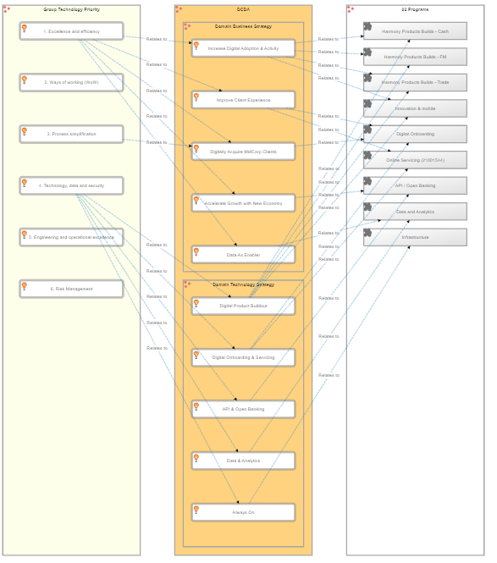
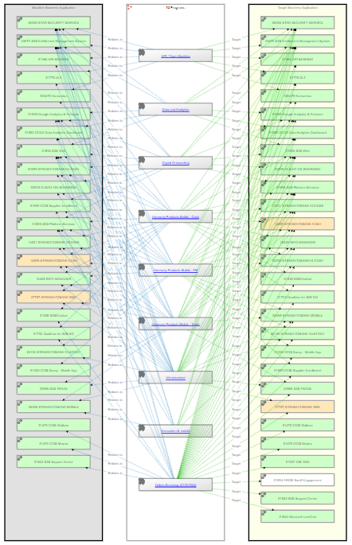
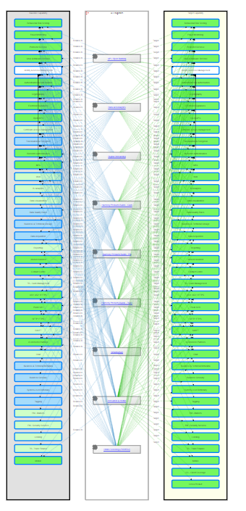
Roadmap – Strategy Aligned Investment (Programs)
Strategic Programs Vs Capability (Baseline & Target)
Strategic Programs Vs Applications (Baseline & Target)
Group Priority
Domain Strategy
Strategic Programs
https://scb.avolutionsoftware.com/?DashboardId=30

Slide 19
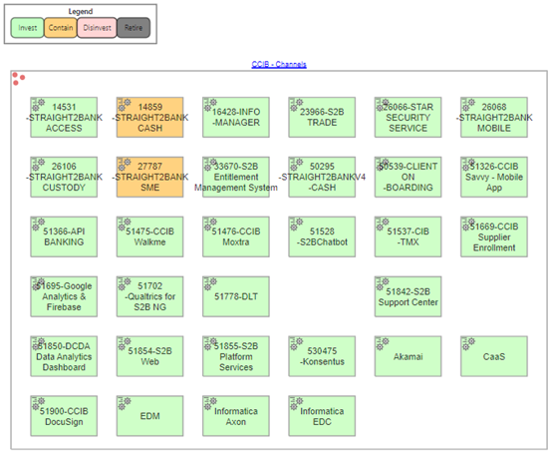
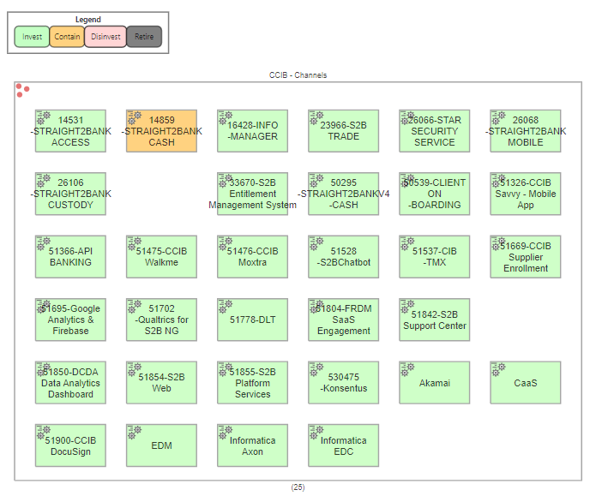
Roadmap – Application Landscape
Baseline
Target

Slide 20
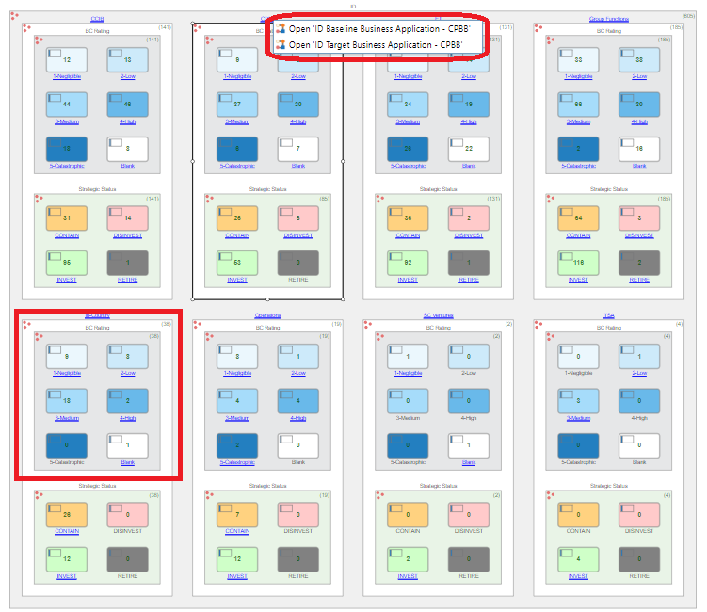
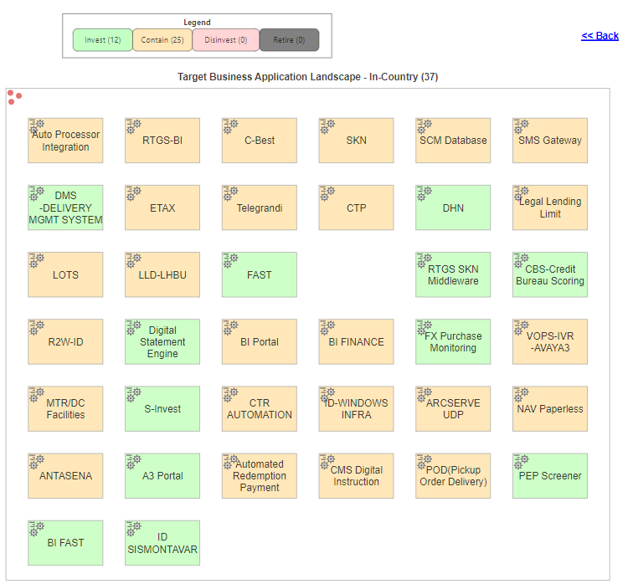
Roadmap – Country View
Overlay with Domain Roadmap with additional in-Country application strategic status
In-Country Application Landscape

Slide 21
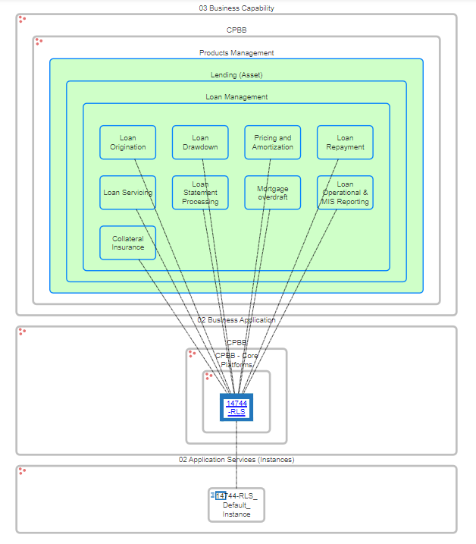
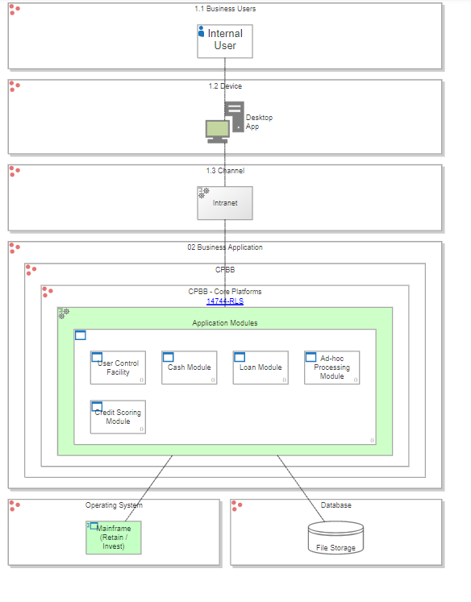
Application Architecture Modelling
Logica Architecture
Capability vs Application Instance

Slide 22
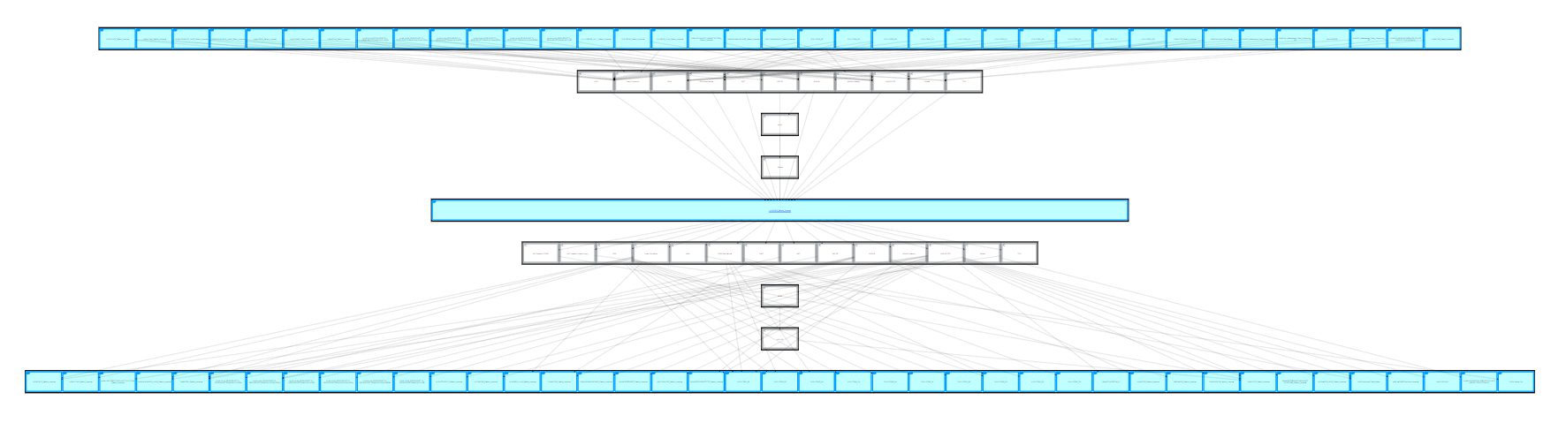
Application Architecture Modelling
- Interface with Integration Layers

Slide 23
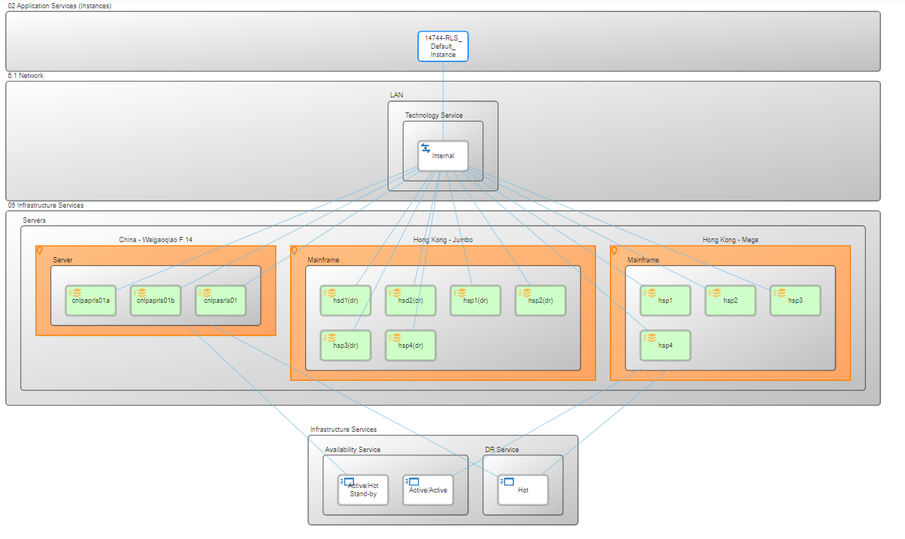
Application Architecture Modelling
- Deployment View

